Slide 1

Introduction to convnets
CS 20: TensorFlow for Deep Learning Research
Lecture 6
1/31/2017

Slide 2
Agenda
Computer Vision
Convolutional Neural Networks
Convolution
Pooling
Feature Visualization
Slides adapted from Justin Johnson
Used with permission.

Slide 3
Convolutional Neural Networks:
Deep Learning with Images

Slide 4
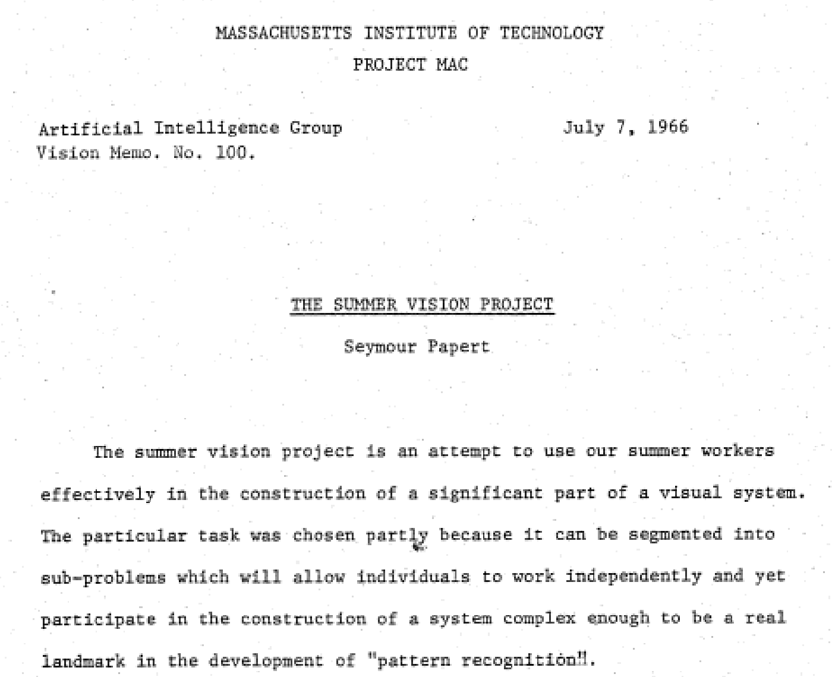
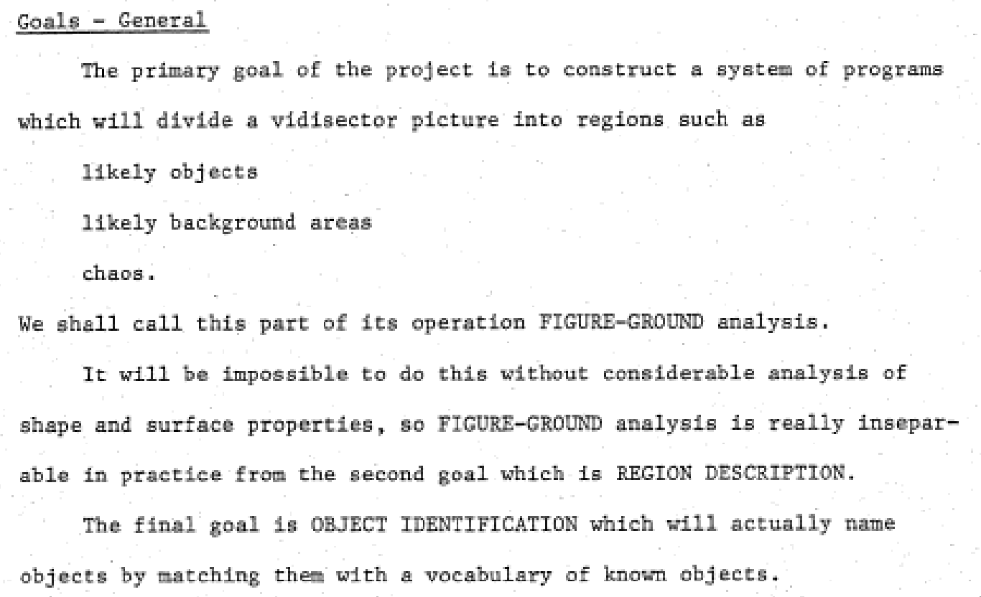
Computer Vision - A bit of history
https://dspace.mit.edu/bitstream/handle/1721.1/6125/AIM-100.pdf
Notes:
Seymour Papert / Marvin Minsky
Student: Gerald Sussman, a well-known computer scientist in his own right

Slide 5
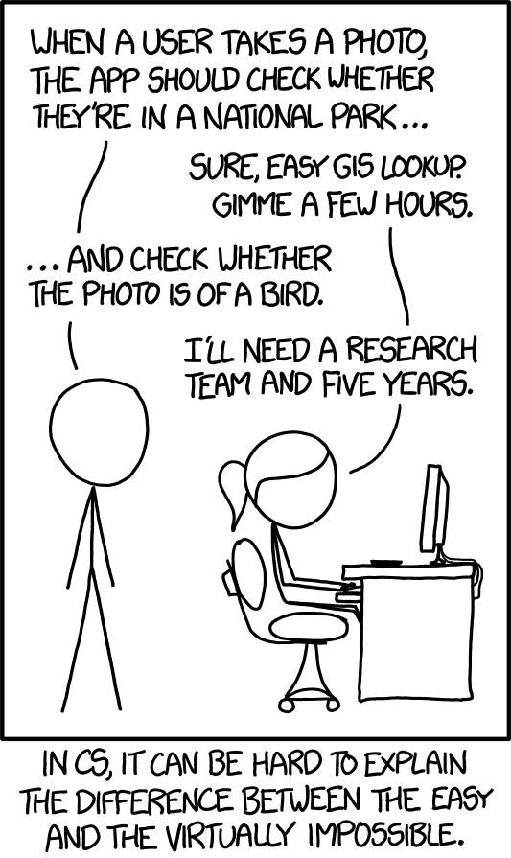
Computer Vision - A bit of history
https://xkcd.com/1425/
Notes:
Describing images is somehow fundamental
Perhaps because so key to our experience perceiving the world
Somehow crazy to think computers haven’t been able to do this with any meaningful accuracy until quite recently

Slide 6
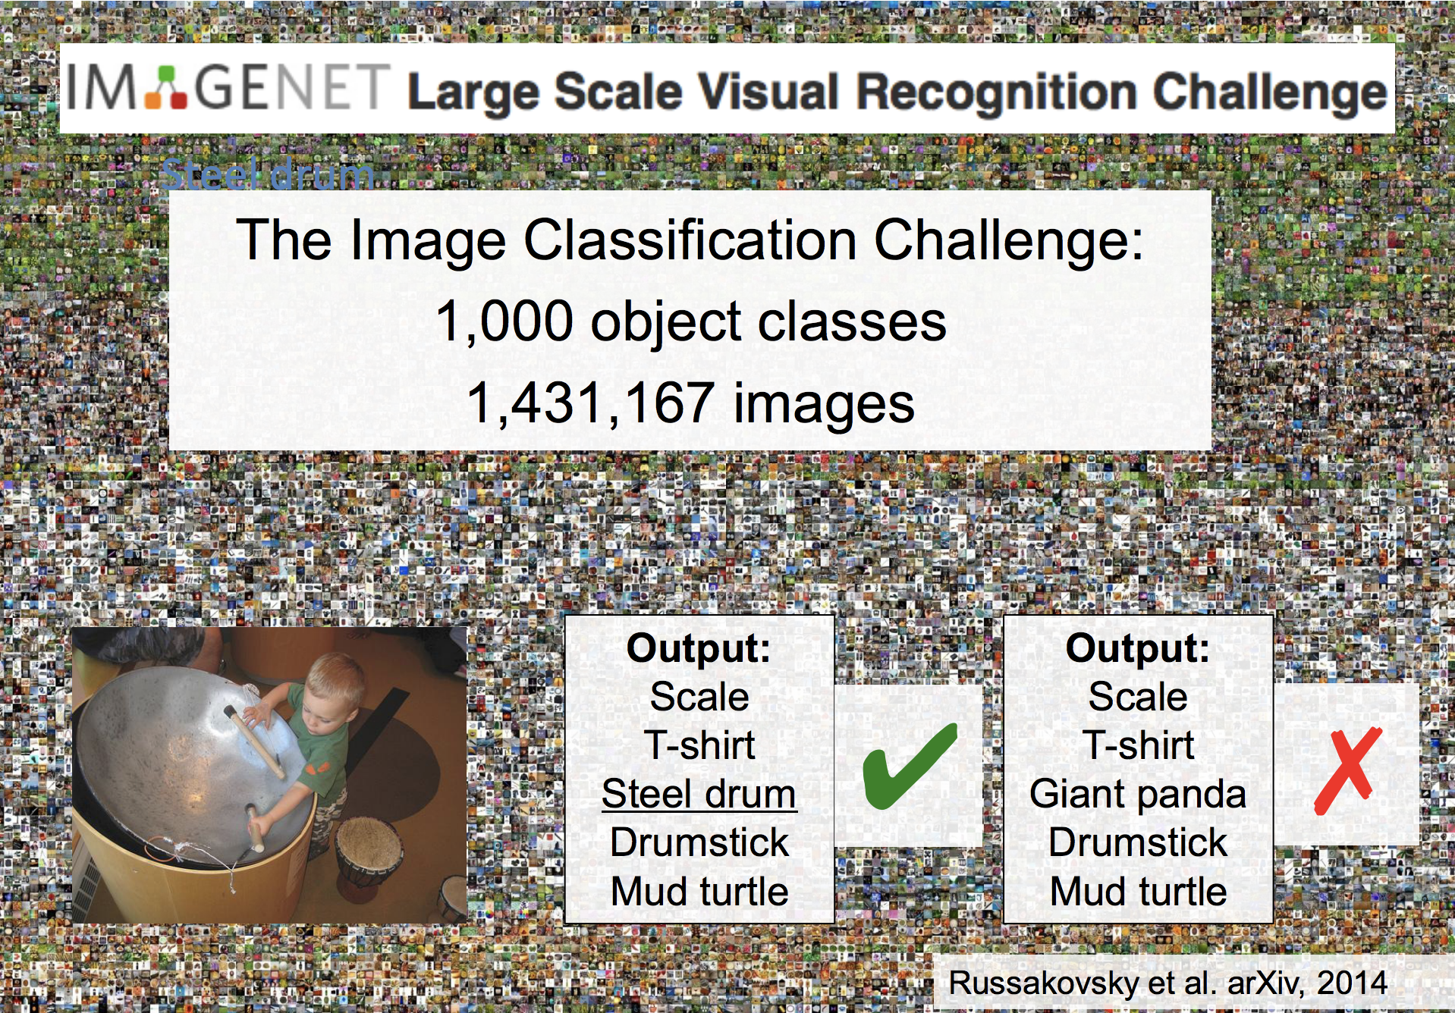

Slide 7
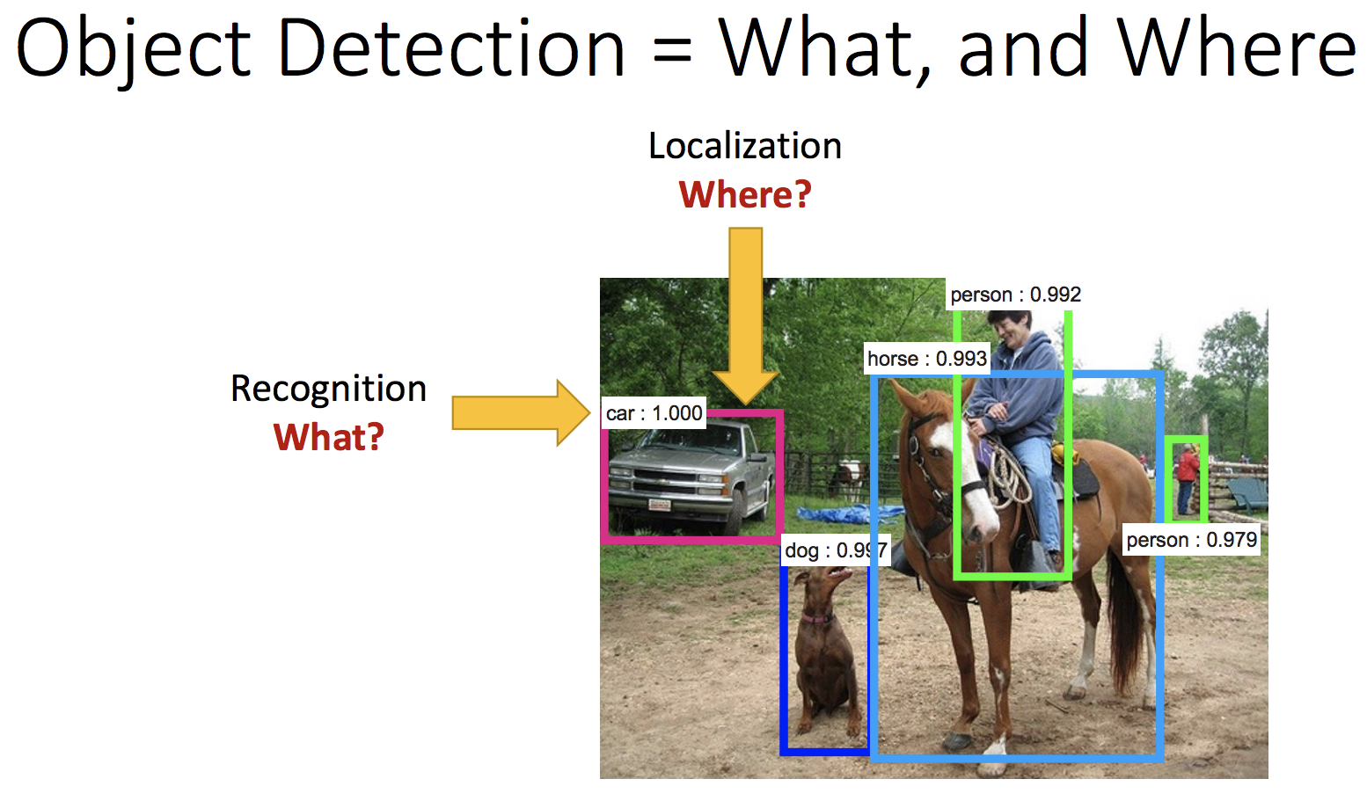

Slide 8
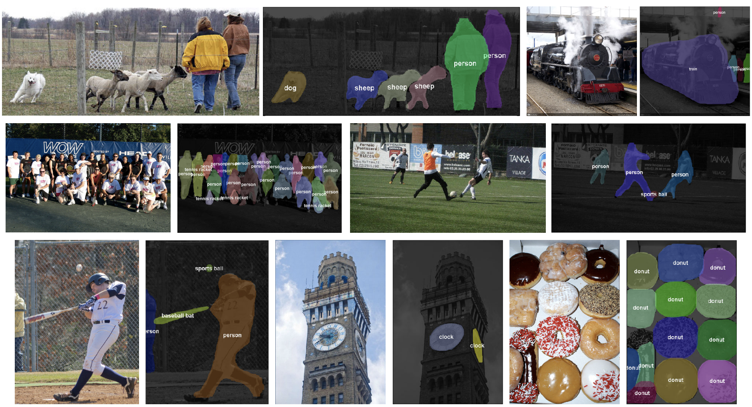
Object Segmentation
Figure credit: Dai, He, and Sun, “Instance-aware Semantic Segmentation via Multi-task Network Cascades”, CVPR 2016

Slide 9
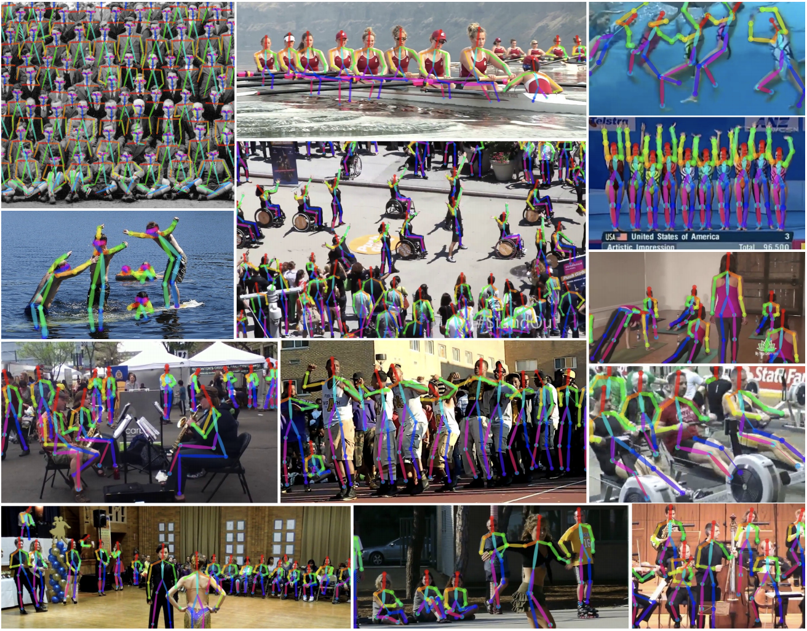
Pose Estimation
Figure credit: Cao et al, “Realtime Multi-Person 2D Pose Estimation using Part Affinity Fields”, arXiv 2016

Slide 10
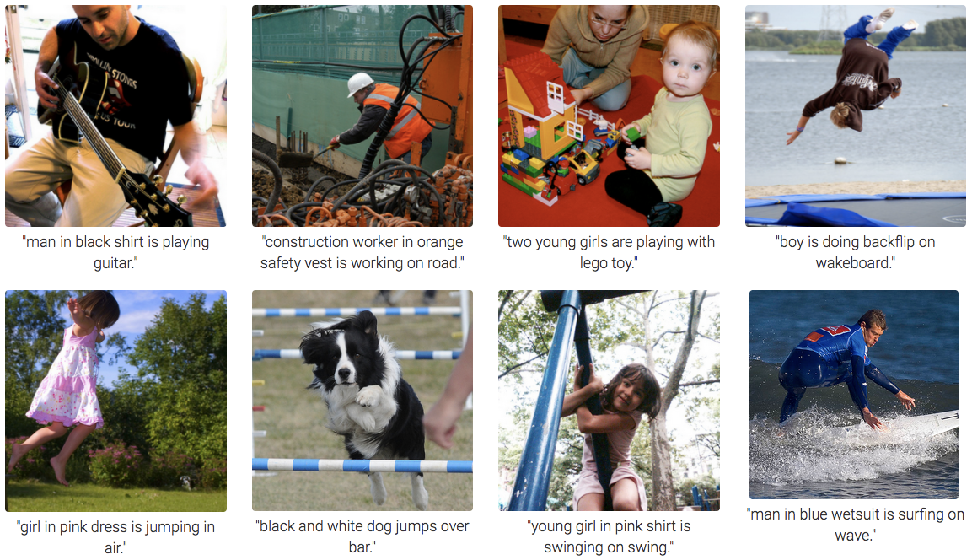
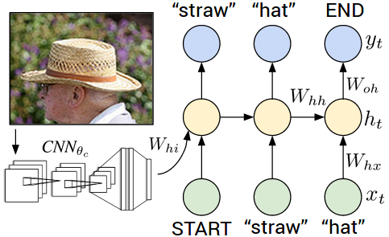
Image Captioning
Figure credit: Karpathy and Fei-Fei, “Deep Visual-Semantic Alignments for Generating Image Descriptions”, CVPR 2015

Slide 11
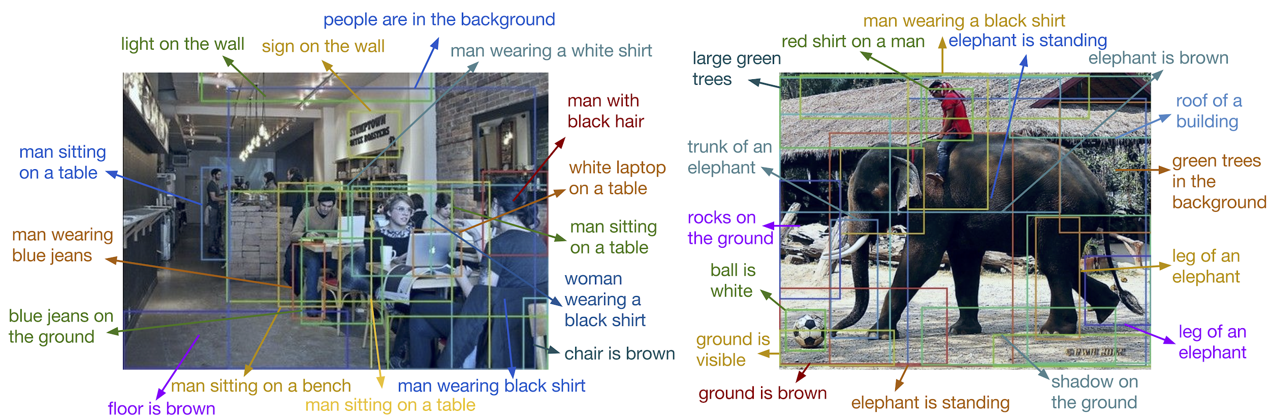
Dense Image Captioning
Figure credit: Johnson*, Karpathy*, and Fei-Fei, “DenseCap: Fully Convolutional Localization Networks for Dense Captioning”, CVPR 2016

Slide 12
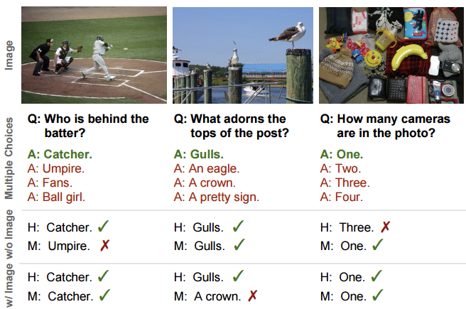
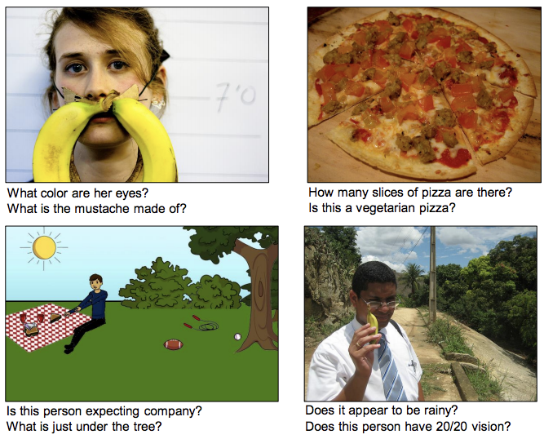
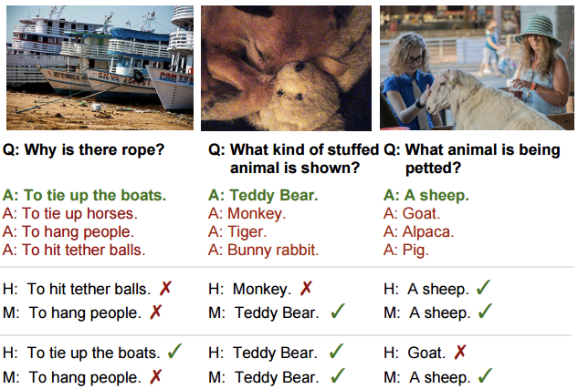
Visual Question Answering
Figure credit: Agrawal et al, “VQA: Visual Question Answering”, ICCV 2015 (left)
Zhu et al, “Visual7W: Grounded Question Answering in Images”, CVPR 2016 (right)
(r

Slide 13
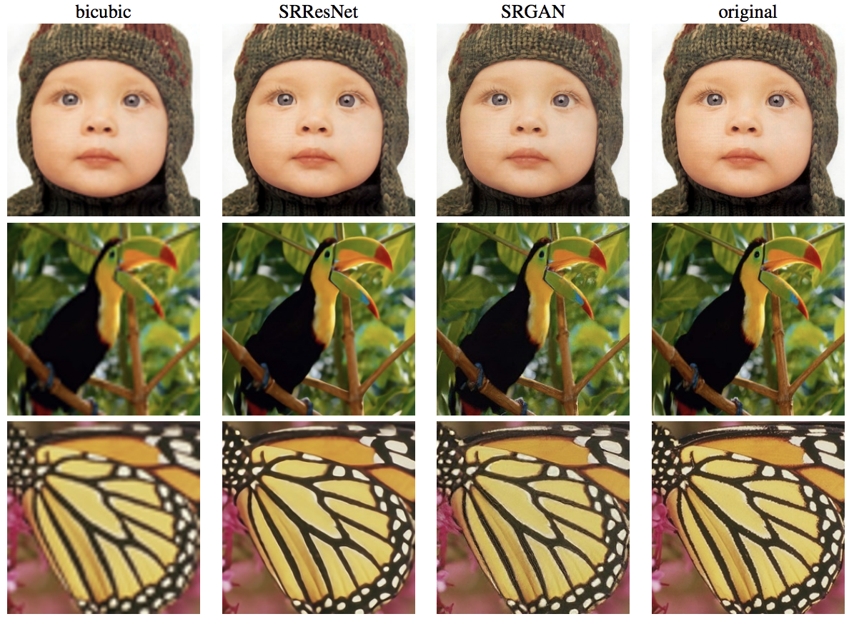
Image Super-resolution
Figure credit: Ledig et al, “Photo-Realistic Single Image Super-Resolution Using a Generative Adversarial Network”, arXiv 2016

Slide 14
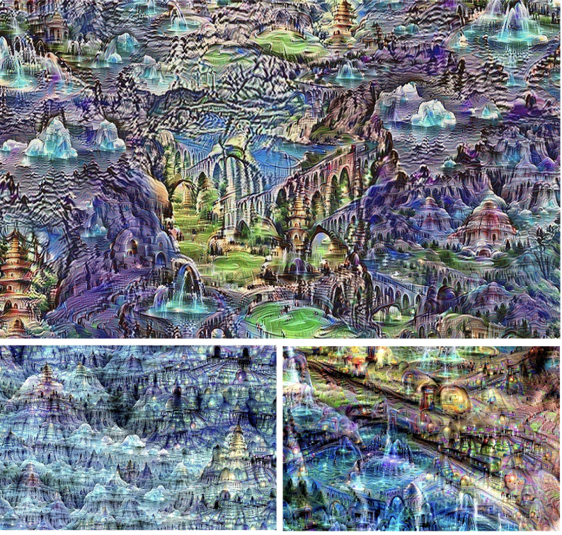
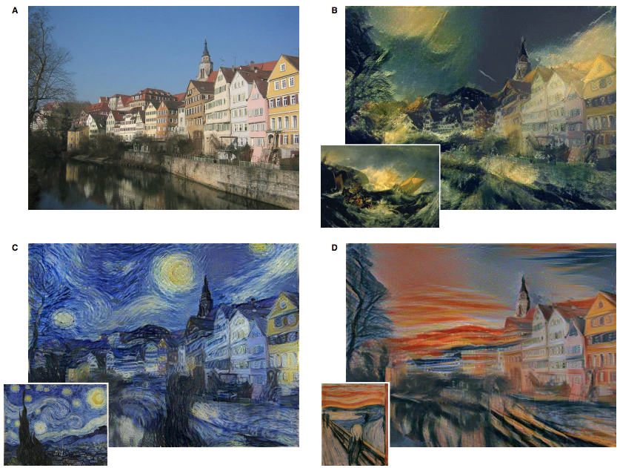
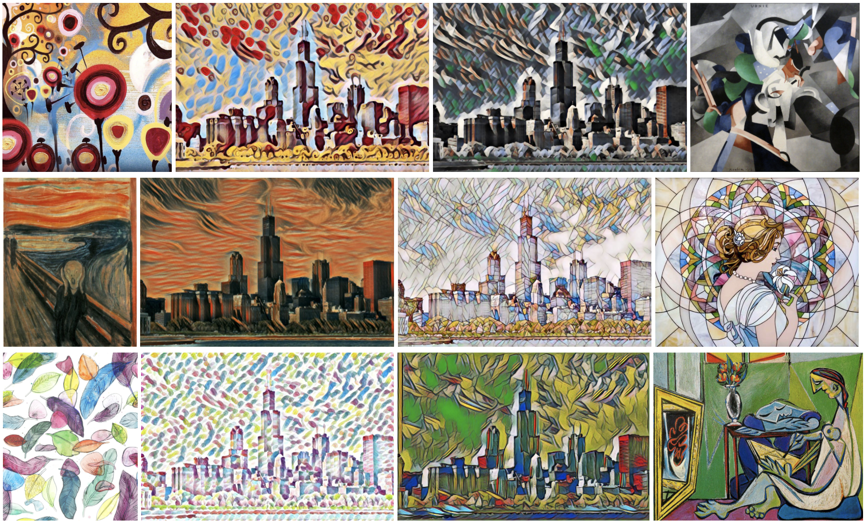
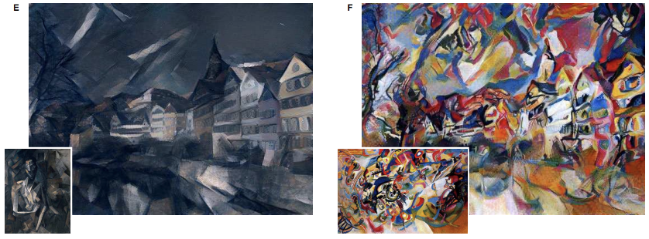
Art generation
Gatys, Ecker, and Bethge, “Image Style Transfer using Convolutional Neural Networks”, CVPR 2016 (left)
Mordvintsev, Olah, and Tyka, “Inceptionism: Going Deeper into Neural Networks” (upper right)
Johnson, Alahi, and Fei-Fei: “Perceptual Losses for Real-Time Style Transfer and Super-Resolution”, ECCV 2016 (bottom left)

Slide 15
Convolutional Neural Networks

Slide 16
Recall: fully connected neural network
Matrix Multiply
Matrix Multiply
Nonlinearity
x
[C₁]
s
[C₂]
a
[C₂]
ŷ
[C₃]
w₁
[C₁×C₂]
w₂
[C₂×C₃]
Notes:
Notice that in each layer, each neuron is connected to each output unit from the previous layer

Slide 17
Recall: fully connected neural network
32x32x3 image -> stretch to 3072 x 1
input
activation
1
1
10 x 3072
weights
3072
10
Notes:
We lose a lot of information by doing this!
Spatial positioning of what’s next to what else

Slide 18
Convolutional Neural Network
Fully
Connected
Nonlinearity
Convolution
Pooling
x
C₁×H×W
s
C₂×H×W
a
C₂×H×W
p
C₂×H/2×W/2
ŷ
C₃
w₁
C₂×C₁×k×k
w₂
C₂HW/4×C₃

Slide 19

Convolution
Image courtesy Apple

Slide 20
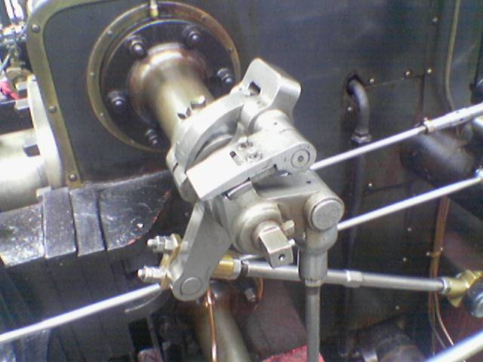
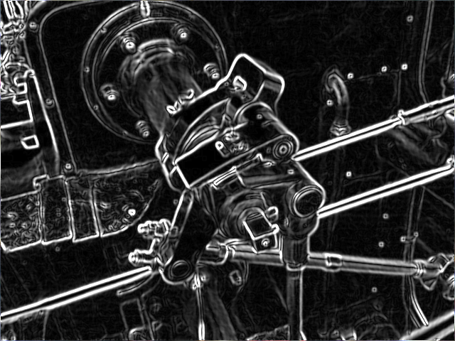
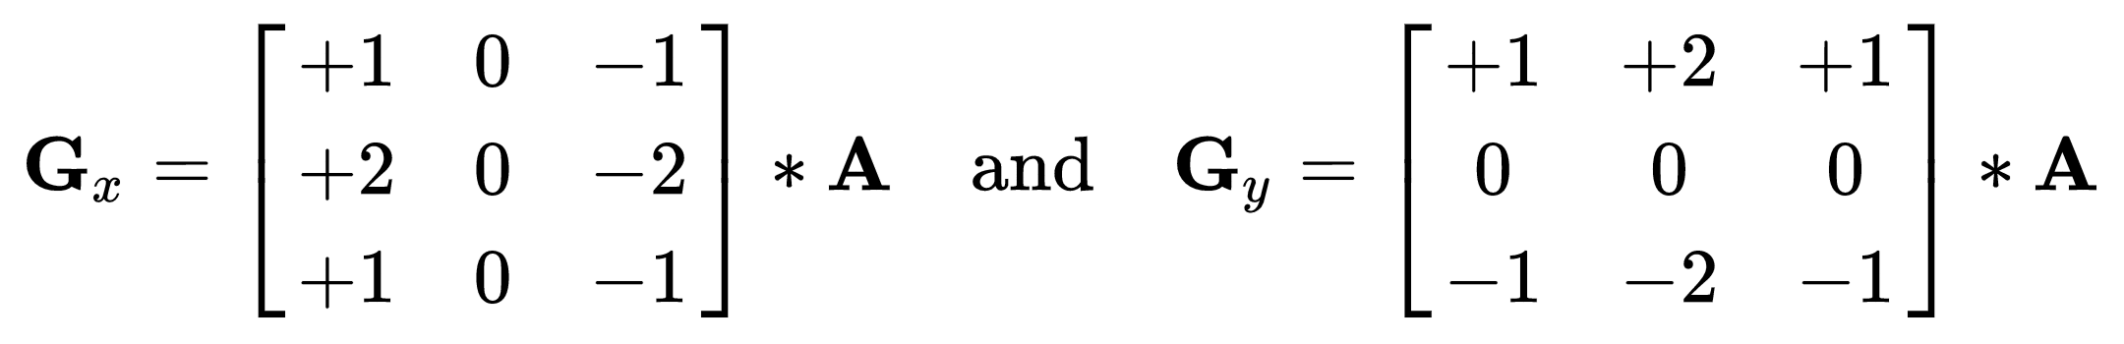
Convolving “filters” is not a new idea
Sobel operator:

Slide 21
Convolution Layer
32x32x3 image
32
height
32
width
3
depth
Slide credit: CS231n Lecture 7

Slide 22
Convolution Layer
32x32x3 image
Filters always extend the full depth of the input volume
32
height
5x5x3 filter
Convolve the filter with the image
i.e. “slide over the image spatially, computing dot products”
32
width
3
depth
Slide credit: CS231n Lecture 7

Slide 23

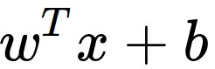
Convolution Layer
32x32x3 image
5x5x3 filter
32
1 number:
the result of taking a dot product between the filter and a small 5x5x3 chunk of the image
(i.e. 5*5*3 = 75-dimensional dot product + bias)
32
3
Slide credit: CS231n Lecture 7

Slide 24
Convolution Layer
activation maps
32x32x3 image
5x5x3 filter
32
28
convolve (slide) over all spatial locations
32
28
3
1
Slide credit: CS231n Lecture 7

Slide 25

Output
Filter
Input
Padding

Slide 26
Convolution Layer
activation maps
32x32x3 image
5x5x3 filter
32
28
convolve (slide) over all spatial locations
32
28
3
2
consider a second, green filter
Slide credit: CS231n Lecture 7

Slide 27
For example, if we had 6 5x5 filters, we’ll get 6 separate activation maps:
activation maps
32
28
Convolution Layer
32
28
3
6
We stack these up to get a new “image” of size 28x28x6!
Slide credit: CS231n Lecture 7

Slide 28
ConvNet is a sequence of Convolution Layers, interspersed with activation functions
32
28
CONV,
ReLU
e.g. 6 5x5x3 filters
32
28
3
6
Slide credit: CS231n Lecture 7

Slide 29
ConvNet is a sequence of Convolution Layers, interspersed with activation functions
32
28
24
….
CONV,
ReLU
e.g. 6 5x5x3 filters
CONV,
ReLU
e.g. 10 5x5x6 filters
CONV,
ReLU
32
28
24
3
6
10
Slide credit: CS231n Lecture 7

Slide 30
Two key insights
Features are hierarchical
Composing high-complexity features out of low-complexity features is more efficient than learning high-complexity features directly.
e.g.: having an “circle” detector is useful for detecting faces… and basketballs
Features are translationally invariant
If a feature is useful to compute at (x, y) it is useful to compute that feature at (x’, y’) as well

Slide 31
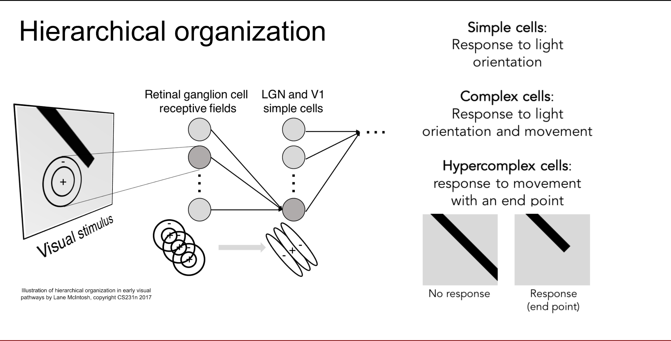

Slide 32
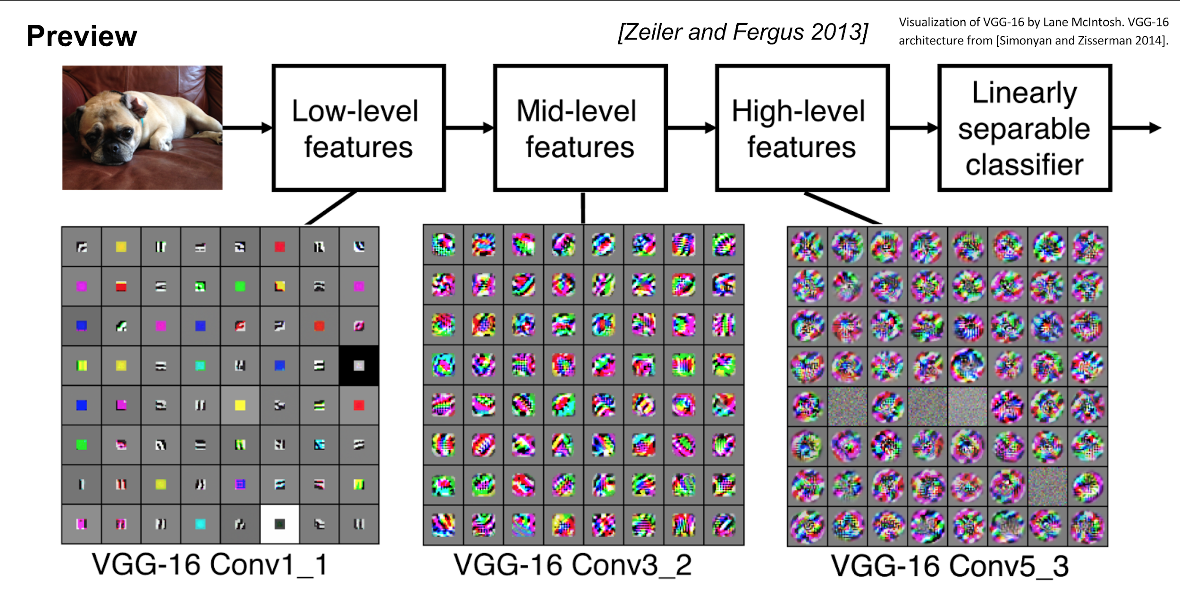

Slide 33
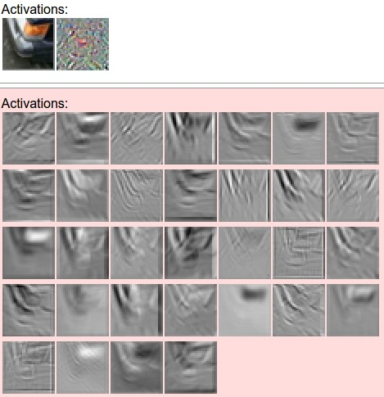
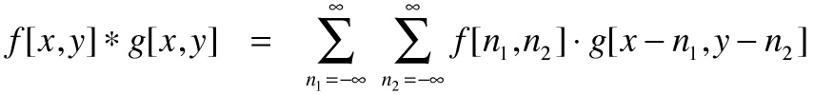
one filter =>
one activation map
example 5x5 filters
(32 total)
We call the layer convolutional because it is related to convolution of two signals:
element-wise multiplication and sum of a filter and the signal (image)
Figure copyright Andrej Karpathy.

Slide 34
A closer look at spatial dimensions:
7
7x7 input (spatially)
assume 3x3 filter
7

Slide 35
A closer look at spatial dimensions:
7
7x7 input (spatially)
assume 3x3 filter
7

Slide 36
A closer look at spatial dimensions:
7
7x7 input (spatially)
assume 3x3 filter
7

Slide 37
A closer look at spatial dimensions:
7
7x7 input (spatially)
assume 3x3 filter
7

Slide 38
A closer look at spatial dimensions:
7
=> 5x5 output
7x7 input (spatially)
assume 3x3 filter
7

Slide 39
A closer look at spatial dimensions:
7
7x7 input (spatially)
assume 3x3 filter
applied with stride 2
7

Slide 40
A closer look at spatial dimensions:
7
7x7 input (spatially)
assume 3x3 filter
applied with stride 2
7

Slide 41
A closer look at spatial dimensions:
7
7x7 input (spatially)
assume 3x3 filter
applied with stride 2
=> 3x3 output!
7

Slide 42
A closer look at spatial dimensions:
7
7x7 input (spatially)
assume 3x3 filter
applied with stride 3?
7

Slide 43
A closer look at spatial dimensions:
7
7x7 input (spatially)
assume 3x3 filter
applied with stride 3?
7
doesn’t fit!
cannot apply 3x3 filter on 7x7 input with stride 3.

Slide 44
N
Output size:
(N - F) / stride + 1
e.g. N = 7, F = 3:
stride 1 => (7 - 3)/1 + 1 = 5
stride 2 => (7 - 3)/2 + 1 = 3
stride 3 => (7 - 3)/3 + 1 = 2.33 :\
F
N
F

Slide 45
In practice: Common to zero pad the border
0 | 0 | 0 | 0 | 0 | 0
0
0
0
0
e.g. input 7x7
3x3 filter, applied with stride 1
pad with 1 pixel border => what is the output?
(recall:)
(N - F) / stride + 1

Slide 46
In practice: Common to zero pad the border
0 | 0 | 0 | 0 | 0 | 0
0
0
0
0
e.g. input 7x7
3x3 filter, applied with stride 1
pad with 1 pixel border => what is the output?
7x7 output!

Slide 47
In practice: Common to zero pad the border
0 | 0 | 0 | 0 | 0 | 0
0
0
0
0
e.g. input 7x7
3x3 filter, applied with stride 1
pad with 1 pixel border => what is the output?
7x7 output!
in general, common to see CONV layers with stride 1, filters of size FxF, and zero-padding with (F-1)/2. (will preserve size spatially)
e.g. F = 3 => zero pad with 1
F = 5 => zero pad with 2
F = 7 => zero pad with 3

Slide 48
Remember back to…
E.g. 32x32 input convolved repeatedly with 5x5 filters shrinks volumes spatially!
(32 -> 28 -> 24 ...). Shrinking too fast is not good, doesn’t work well.
32
28
24
….
CONV,
ReLU
e.g. 6 5x5x3 filters
CONV,
ReLU
e.g. 10 5x5x6 filters
CONV,
ReLU
32
28
24
3
6
10

Slide 49
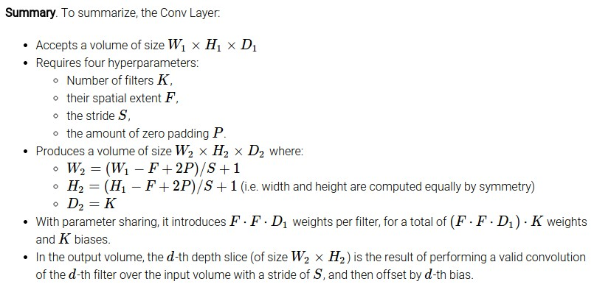
Common settings:
K = (powers of 2, e.g. 32, 64, 128, 512)
F = 3, S = 1, P = 1
F = 5, S = 1, P = 2
F = 5, S = 2, P = ? (whatever fits)
F = 1, S = 1, P = 0

Slide 50
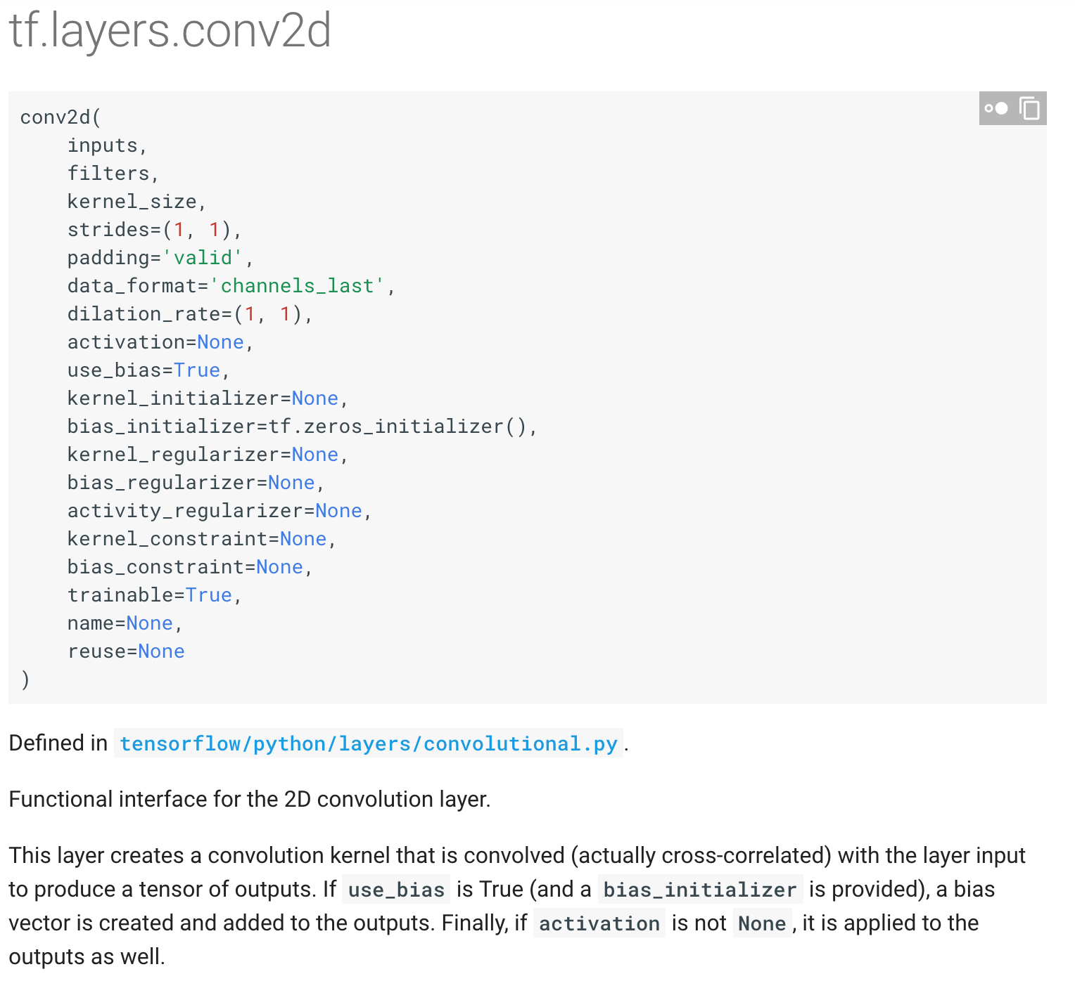
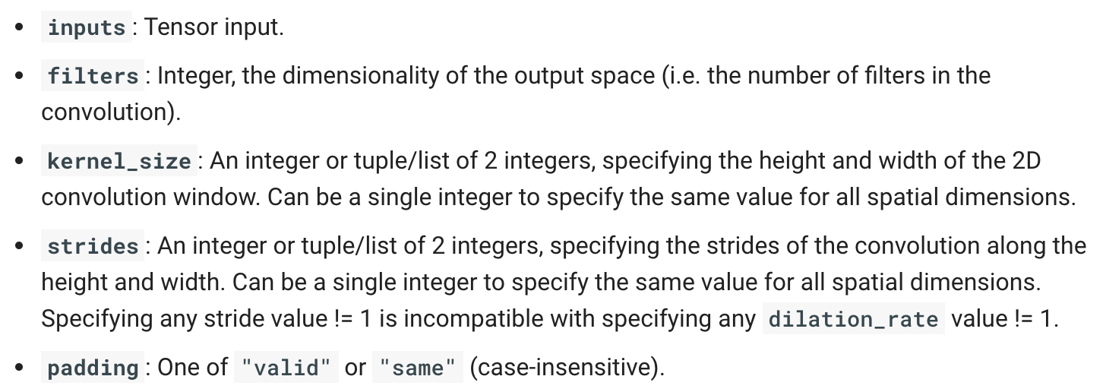

Slide 51
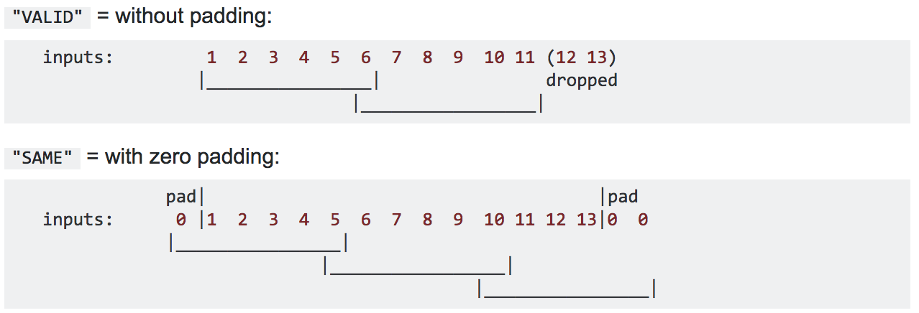
TensorFlow Padding Options
Input width = 13
Filter width = 6
Stride = 5
Notes:
"VALID" only ever drops the right-most columns (or bottom-most rows).
"SAME" tries to pad evenly left and right, but if the amount of columns to be added is odd, it will add the extra column to the right, as is the case in this example (the same logic applies vertically: there may be an extra row of zeros at the bottom).

Slide 52

Pooling Layer
makes the representations smaller and more manageable
operates over each activation map independently
Slide credit: CS231n Lecture 7

Slide 53
Max Pooling
Single depth slice
1 | 1 | 2 | 4
5 | 6 | 7 | 8
3 | 2 | 1 | 0
1 | 2 | 3 | 4
x
max pool with
2x2 filters and stride 2
6 | 8
3 | 4
y
Slide credit: CS231n Lecture 7

Slide 54
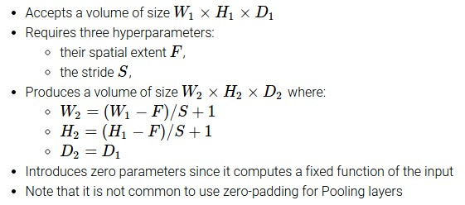
Max Pooling
Common settings:
F = 2, S = 2
F = 3, S = 2
Slide credit: CS231n Lecture 7

Slide 55

Case study: LeNet-5 [LeCun et al., 1998]
Conv filters were 5x5, applied at stride 1
Subsampling (Pooling) layers were 2x2 applied at stride 2
i.e. architecture is [CONV-POOL-CONV-POOL-CONV-FC]
Slide credit: CS231n Lecture 7

Slide 56
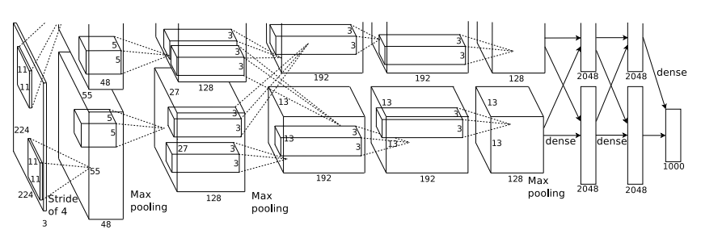
Case study: AlexNet [Krizhevsky et al. 2012]
Full (simplified) AlexNet architecture
[227x227x3] INPUT
[55x55x96] CONV1: 96 11x11 filters at stride 4, pad 0
[27x27x96] MAX POOL1: 3x3 filters at stride 2
[27x27x96] NORM1: Normalization layer
[27x27x256] CONV2: 256 5x5 filters at stride 1, pad 2
[13x13x256] MAX POOL2: 3x3 filters at stride 2
[13x13x256] NORM2: Normalization layer
[13x13x384] CONV3: 384 3x3 filters at stride 1, pad 1
[13x13x384] CONV4: 384 3x3 filters at stride 1, pad 1
[13x13x256] CONV5: 256 3x3 filters at stride 1, pad 1
[6x6x256] MAX POOL3: 3x3 filters at stride 2
[4096] FC6: 4096 neurons
[4096] FC7: 4096 neurons
[1000] FC8: 1000 neurons (class scores)
Slide credit: CS231n Lecture 7

Slide 57
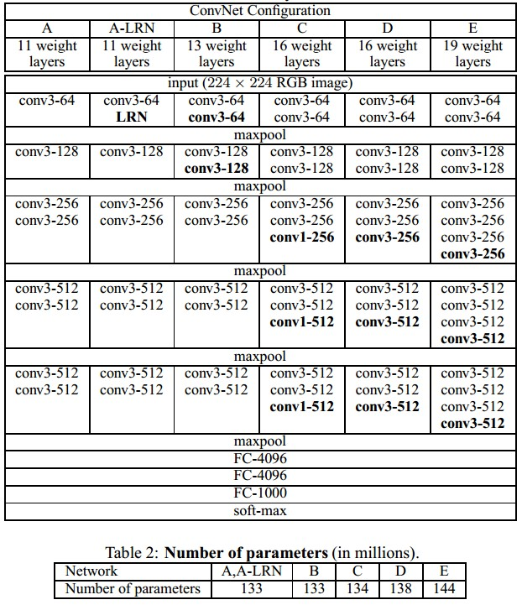
Case study: VGGNet [Simonyan and Zisserman, 2014]
Only 3x3 CONV stride 1, pad 1
and 2x2 MAX POOL stride 2
best model
11.2% top 5 error in ILSVRC 2013
-> 7.3% top 5 error
Slide credit: CS231n Lecture 7

Slide 58

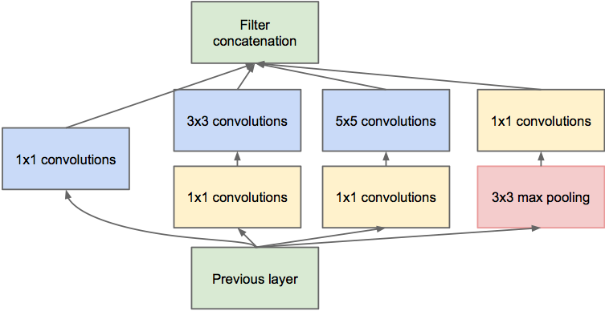
Case study: GoogLeNet [Szegedy et al., 2014]
Inception module
ILSVRC 2014 winner (6.7% top 5 error)
Slide credit: CS231n Lecture 7

Slide 59
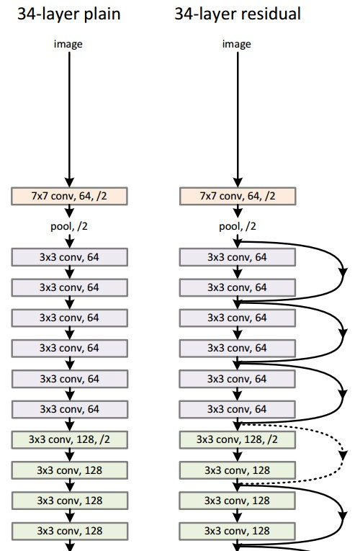
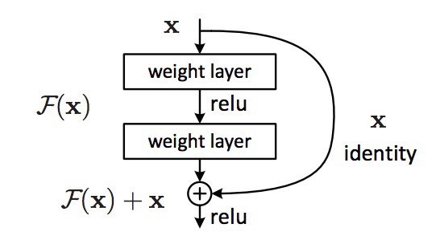
Case study: ResNet [He et al., 2015]
spatial dimension only 56x56!
Slide credit: CS231n Lecture 7
Notes:
Intuitively, deeper nets should perform no worse than their shallower counterparts, at least at train time (when there is no risk of overfitting). As a thought experiment, let’s say we’ve built a net with n layers that achieves a certain accuracy. At minimum, a net with n+1 layers should be able to achieve the exact same accuracy, if only by copying over the same first n layers and performing an identity mapping for the last layer. Similarly, nets of n+2, n+3, and n+4 layers could all continue performing identity mappings and achieve the same accuracy. In practice, however, these deeper nets almost always degrade in performance.
The authors of ResNet boiled these problems down to a single hypothesis: direct mappings are hard to learn. And they proposed a fix: instead of trying to learn an underlying mapping from x to H(x), learn the difference between the two, or the “residual.” Then, to calculate H(x), we can just add the residual to the input.
Say the residual is F(x)=H(x)-x. Now, instead of trying to learn H(x) directly, our nets are trying to learn F(x)+x.
Each “block” in ResNet consists of a series of layers and a “shortcut” connection adding the input of the block to its output. The “add” operation is performed element-wise, and if the input and output are of different sizes, zero-padding or projections (via 1x1 convolutions) can be used to create matching dimensions.

Slide 60
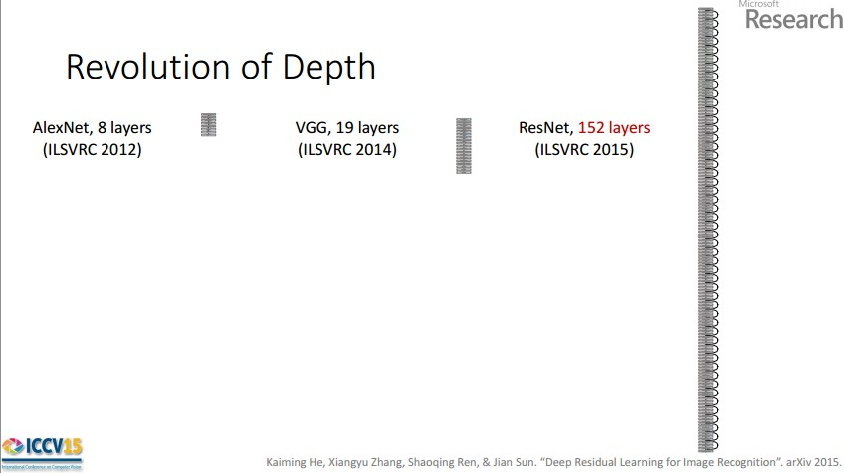
Case study: ResNet [He et al., 2015]
2-3 weeks of training on 8 GPU machine
at runtime: faster than a VGGNet!
(even though it has 8x more layers)
ILSVRC 2015 winner
(3.6% top 5 error)
(slide from Kaiming He’s ICCV 2015 presentation)
Slide credit: CS231n Lecture 7

Slide 61
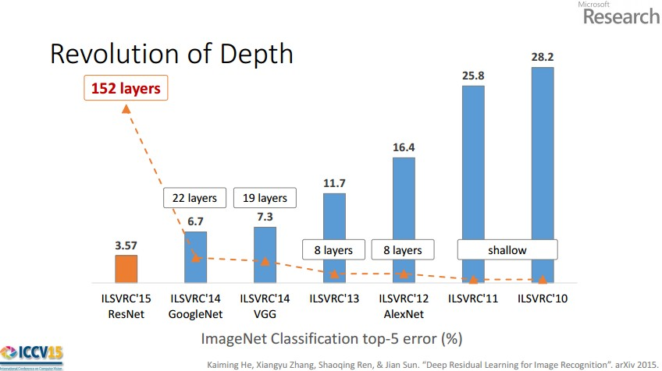
Case study: ResNet [He et al., 2015]
(slide from Kaiming He’s ICCV 2015 presentation)
Slide credit: CS231n Lecture 7

Slide 62
Visualizing ConvNet Features

Slide 63
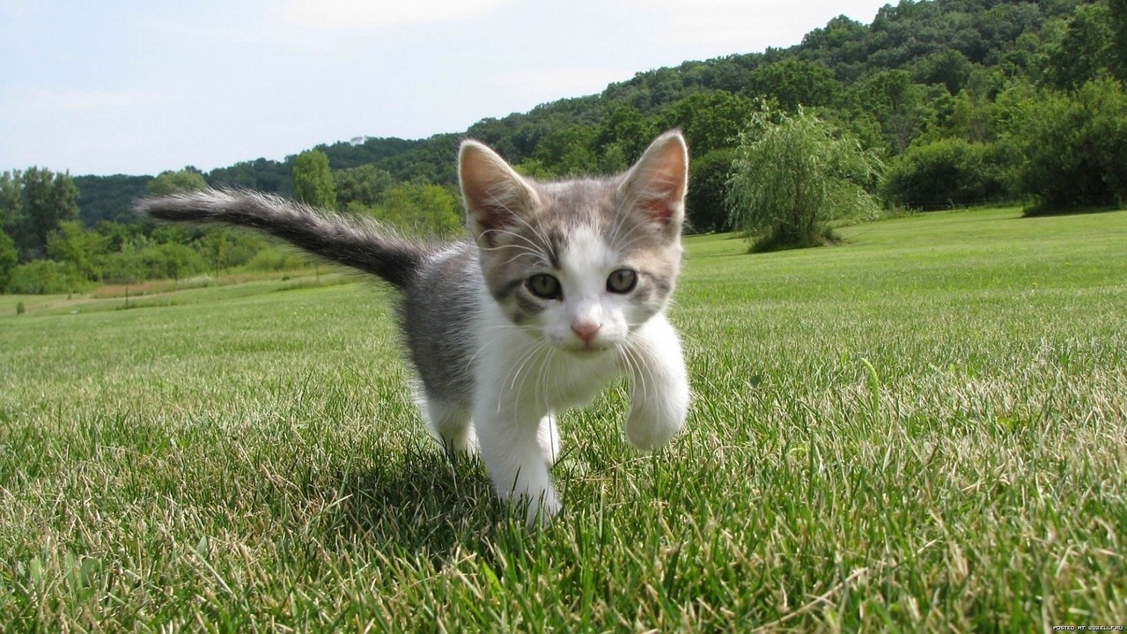
What’s going on inside ConvNets?
This image is CC0 public domain
Class Scores:
1000 numbers
Input Image:
3 x 224 x 224
What are the intermediate features looking for?
Krizhevsky et al, “ImageNet Classification with Deep Convolutional Neural Networks”, NIPS 2012. Figure reproduced with permission.

Slide 64
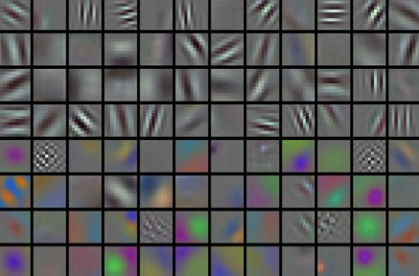
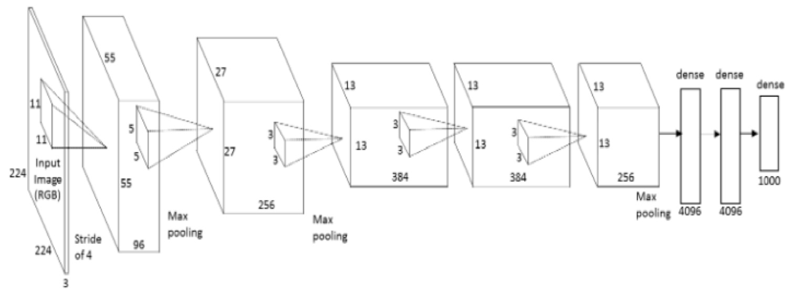
Visualizing CNN features: Look at filters
conv1
Slide credit: CS231n Lecture 9

Slide 65
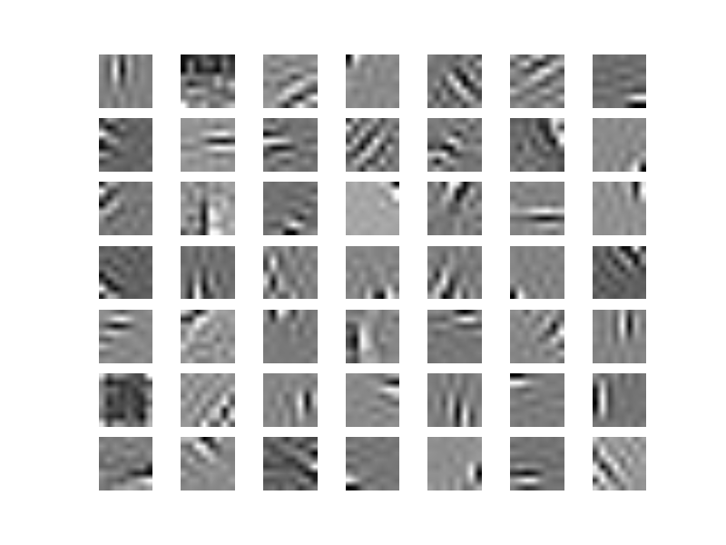
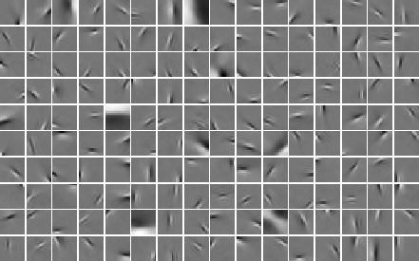
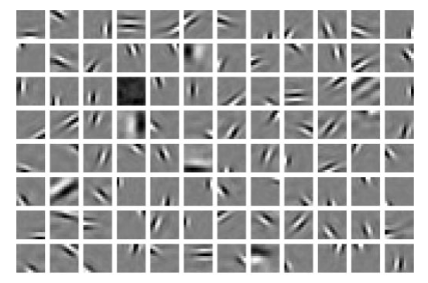
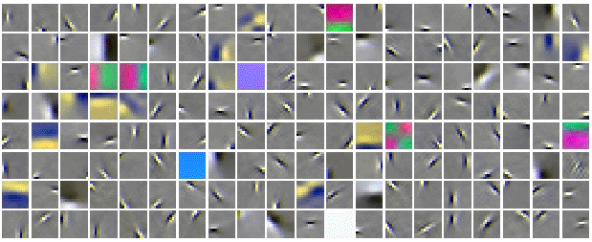
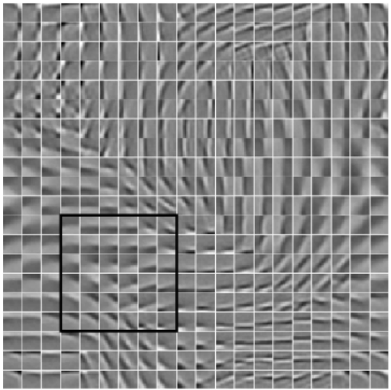
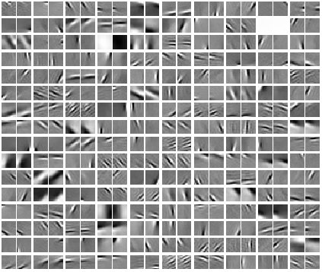
First layers: networks learn similar features
Slide credit: CS231n Lecture 9

Slide 66
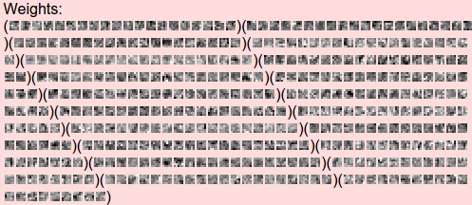
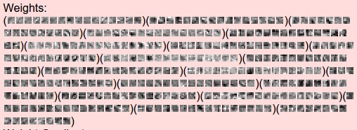
Visualizing CNN features: Look at filters
Filters from higher layers don’t make much sense
Slide credit: CS231n Lecture 9
Filters from ConvNetJS CIFAR-10 model

Slide 67
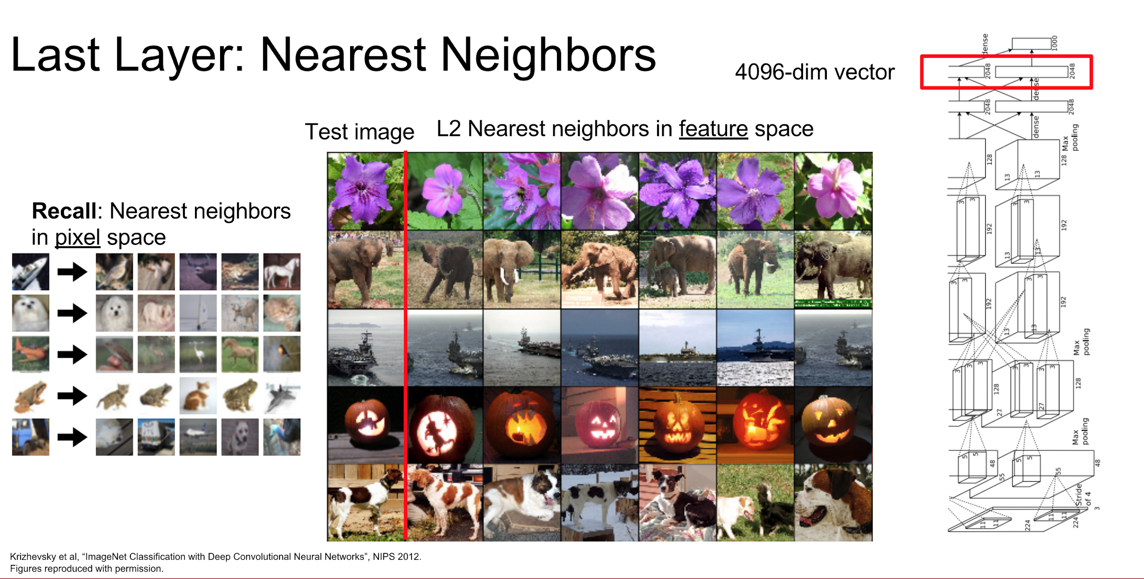

Slide 68


Slide 69


Slide 70

Visualizing CNN features: (guided) backprop
Choose an image
Choose a layer and a neuron in a CNN
Question: How does the chosen neuron respond to the image?
Slide credit: CS231n Lecture 9

Slide 71


Visualizing CNN features: (guided) backprop
Feed image into net
2. Set gradient of chosen layer to all zero, except 1 for the chosen neuron
3. Backprop to image:
Guided
backpropagation:
instead
Zeiler and Fergus, “Visualizing and Understanding Convolutional Networks”, ECCV 2014. Dosovitskiy et al., “Striving for Simplicity: The All Convolutional Net”, ICLR Workshop 2015 Slide credit: CS231n Lecture 9

Slide 72

Visualizing CNN features: (guided) backprop
Visualization of patterns learned by the layer conv6 (top) and layer conv9 (bottom) of the network trained on ImageNet.
Each row corresponds to one filter.
The visualization using “guided backpropagation” is based on the top 10 image patches activating this filter taken from the ImageNet dataset.
Dosovitskiy et al, “Striving for Simplicity: The All Convolutional Net”, ICLR Workshop 2015
Slide credit: CS231n Lecture 9

Slide 73
Visualizing CNN features: Gradient ascent
(Guided) backprop:
Find the part of an image that a neuron responds to
Gradient ascent:
Generate a synthetic image that maximally activates a neuron
I* = arg max_{I} f(I) + R(I)
Neuron value
Natural image regularizer
Slide credit: CS231n Lecture 9

Slide 74

Visualizing CNN features: Gradient ascent
Initialize image to zeros
score for class c (before Softmax)
zero image
Repeat:
2. Forward image to compute current scores
3. Set gradient of scores to be 1 for target class, 0 for others
4. Backprop to get gradient on image
5. Make a small update to the image
Simonyan et al, “Deep Inside Convolutional Networks: Visualising Image Classification Models and Saliency Maps”, ICLR Workshop 2014

Slide 75


Visualizing CNN features: Gradient ascent
Simonyan et al, “Deep Inside Convolutional Networks: Visualising Image Classification Models and Saliency Maps”, ICLR Workshop 2014

Slide 76

Visualizing CNN features: Gradient ascent
Better image regularizers give prettier results:
Yosinski et al, “Understanding Neural Networks Through Deep Visualization”, ICML DL Workshop 2015

Slide 77

Visualizing CNN features: Gradient ascent
Use the same approach to visualize intermediate features
Yosinski et al, “Understanding Neural Networks Through Deep Visualization”, ICML DL Workshop 2015

Slide 78
Visualizing CNN features: Gradient ascent
Use the same approach to visualize intermediate features
Yosinski et al, “Understanding Neural Networks Through Deep Visualization”, ICML DL Workshop 2015

Slide 79

Visualizing CNN features: Gradient ascent
You can add even more tricks to get nicer results
Nguyen et al, “Multifaceted Feature Visualization: Uncovering the Different Types of Features Learned By Each Neuron in Deep Neural Networks”, ICML Visualization for Deep Learning Workshop 2016

Slide 80
Take-aways
Convolutional networks are tailor-made for computer vision tasks.
They exploit:
Hierarchical nature of features
Translation invariance of features
“Understanding” what a convnet learns is non-trivial, but some clever approaches exist.

Slide 81
Next class
ConvNet in TensorFlow
Feedback: huyenn@stanford.edu
Thanks!

